Slide 1
Smart parking
Team members
G.ATCHAYA-821021104012
S. ROSHINI VINNARASI-821021104037
A.THOUMIYA-821021104050
A.JOY RAMILA-821021104025
D.AARTHI-821021104002

Slide 2
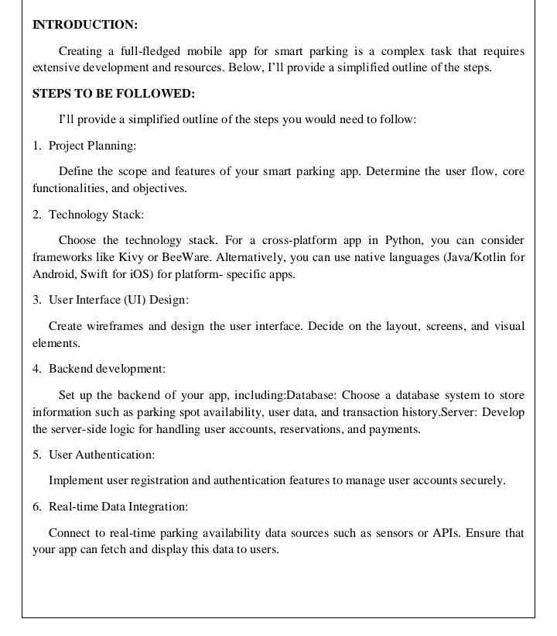

Slide 3
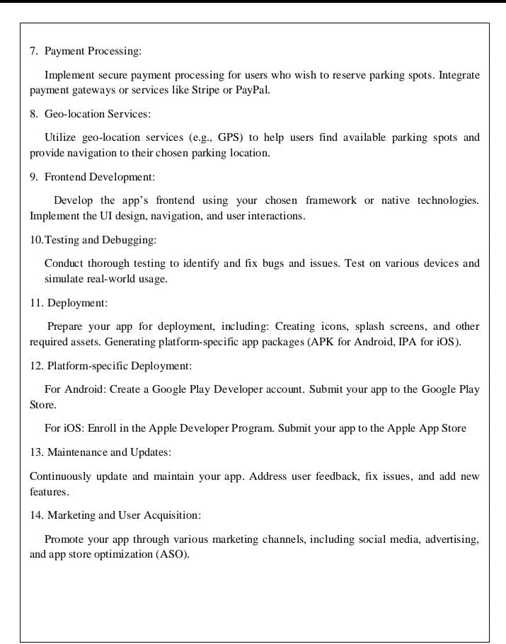

Slide 4
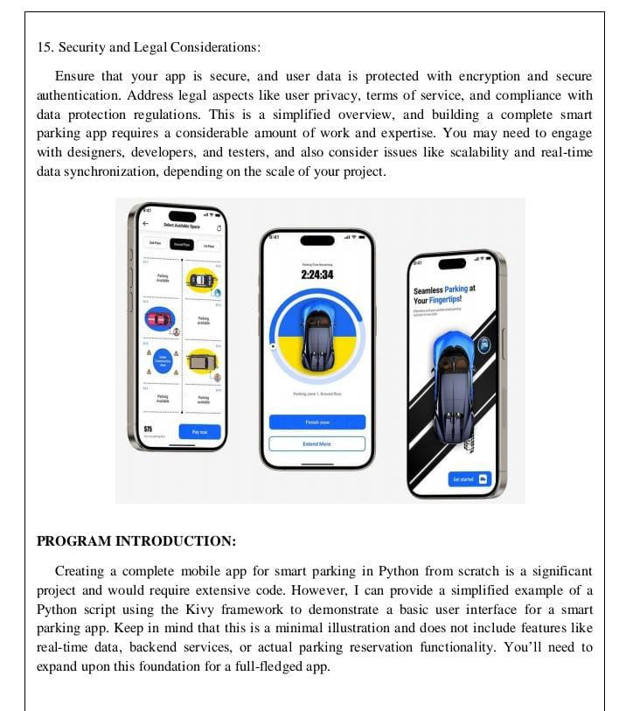

Slide 5
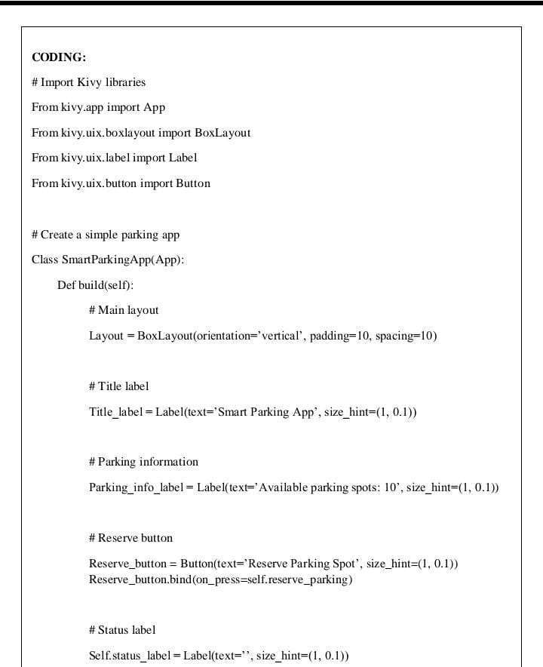

Slide 6
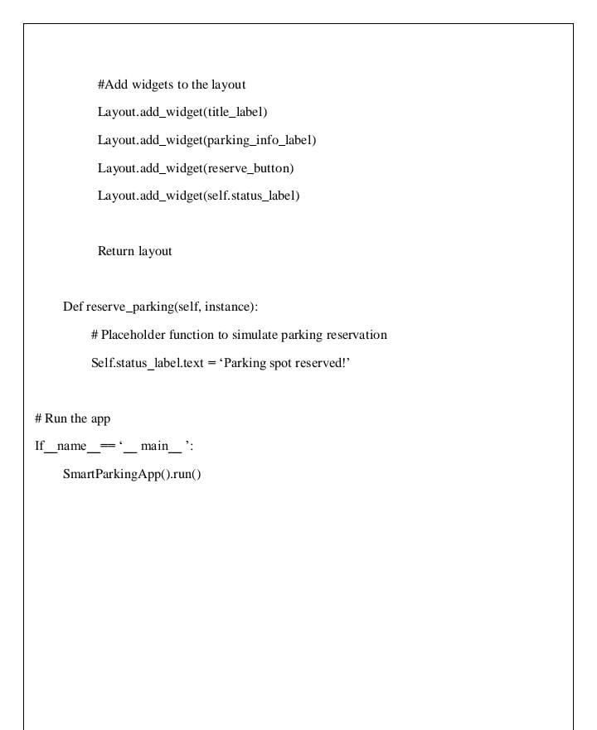

Slide 7
